Slide 1

LINUX – THE LINUX TERMINAL IN DEPTH
Docente: Dott. Daniele Gobbo Modulo 3

Slide 2
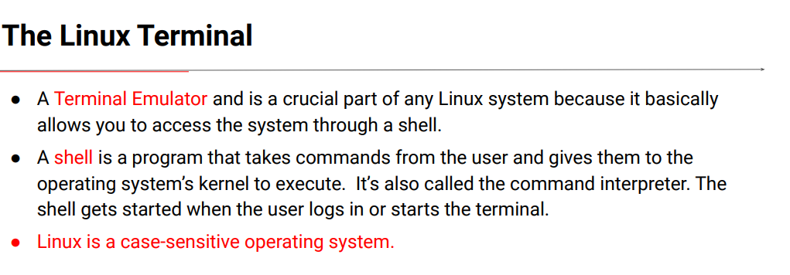
THE LINUX TERMINAL
It is actually called a terminal emulator and is a crucial part of any Linux system because it basically allows you to access the system through a shell.
It's a program that opens a window and lets you writecommands.There are a bunch of terminal programs available, but the most used one is the gnome-terminal, which is the default terminal in Ubuntu and CentOS.
Other terminal emulator applications are: konsole, xterm, guake or terminator.

Slide 3
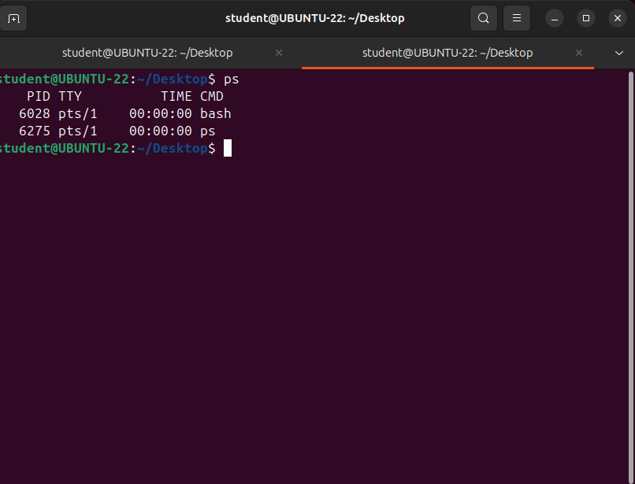

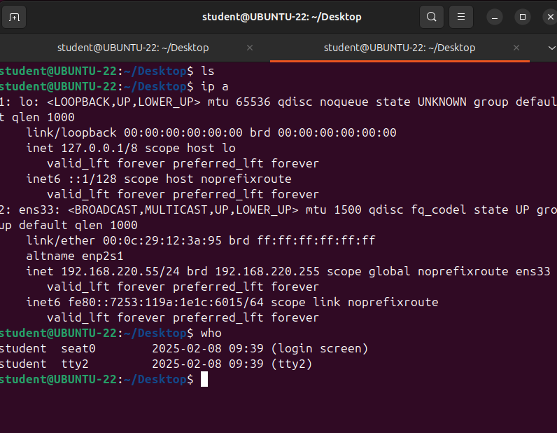
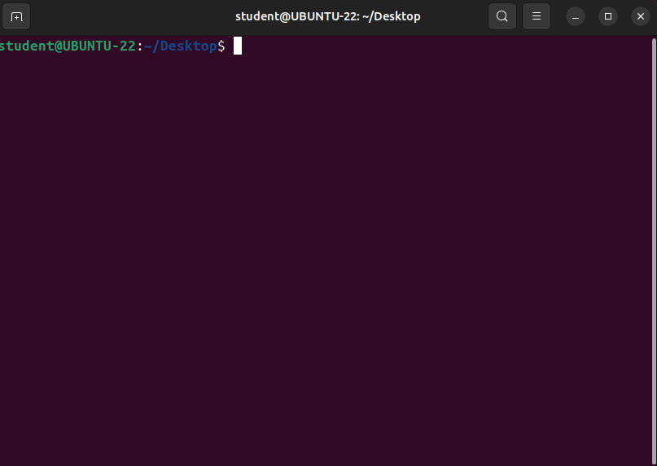
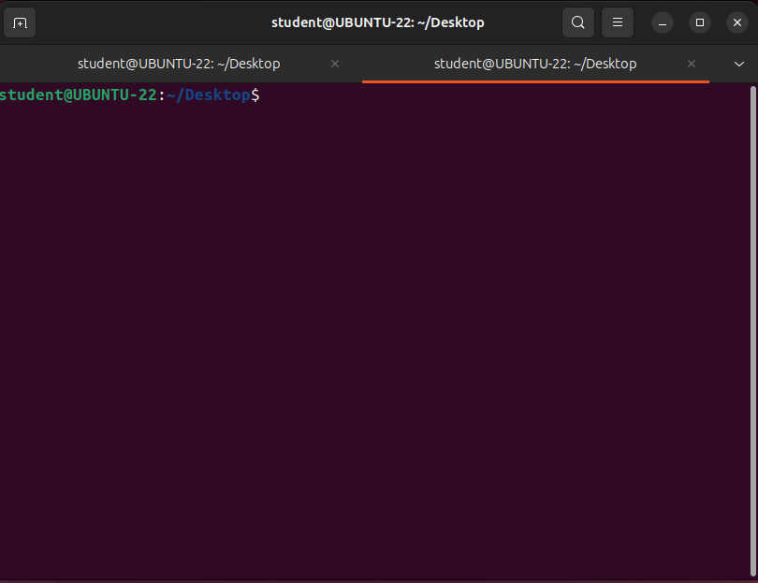
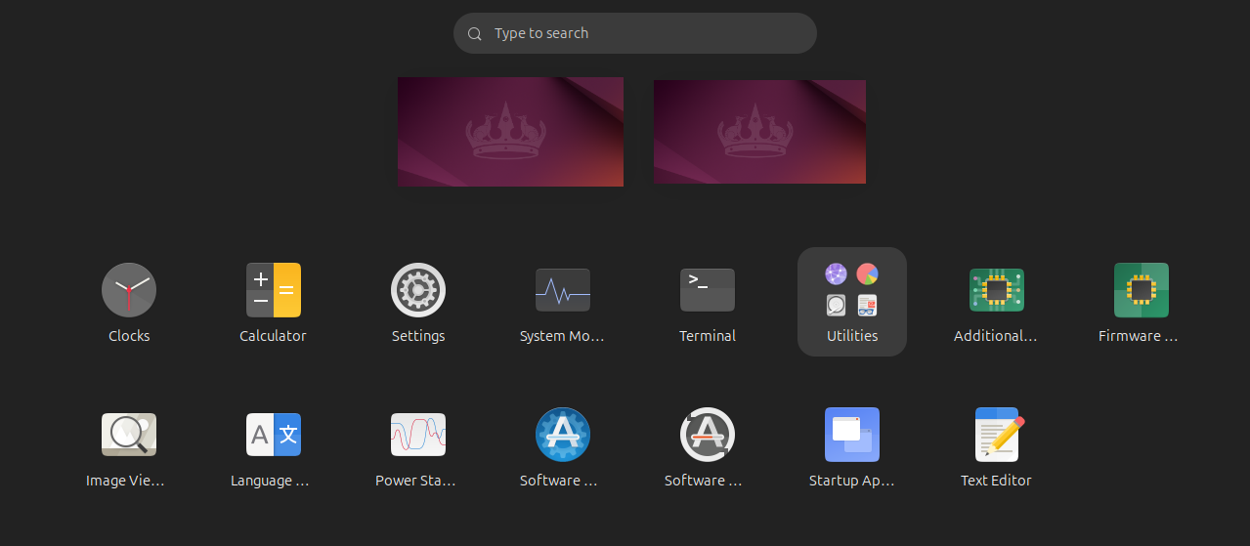
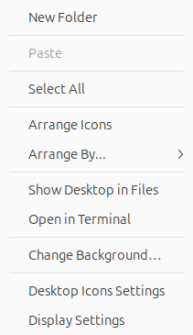

THE LINUX TERMINAL
But what is a shell? Simply put, a Shell is a program that takes commands from the user. through the keyboard and gives them to the operating system’s kernel to get executed.
It's also called the command interpreter because it accepts commands from the user and then checks or interprets them to see if they are syntactically correct.
And if they are, the shell will send them to the kernel for execution.
There are several shells available, but the most widely used one is called Bash.
It is the default location for many Linux distributions, including Ubuntu, Linux Mint, Debian, CentOS
and Mac OS as well.
If you run Windows subsystem for Linux or WSL on Windows 10 Bash is also the default shell.
Other applications besides Bash are Bourne Shell, C Shell,Korn Shell or Z Shell.
An important thing to know is that Linux is a case sensitive operating system, which means that it’s sensitive to the capitalization of letters.
This is different compared to Windows, which is case insensitive.
From now, we'll consider the commands and options as written in lowercase letters, if I don't specify otherwise.
In this terminal, the Bash shell was started. We've discussed terminal essentials, but didn't say a word about consoles. What is a console?
The console is a special sort of terminal that starts if no GUI was installed.
So the terminal and the console are similar.
You start a terminal in a graphical interface, and the console, in a text only interface.
To enter console: ctrl + alt + F1 to F8
To exit console: alt+F2

Slide 4
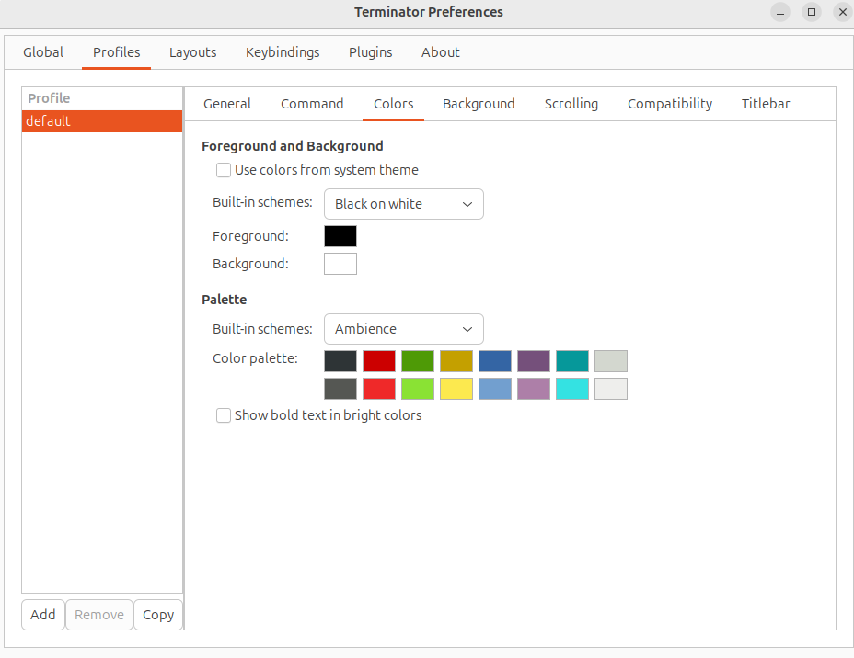
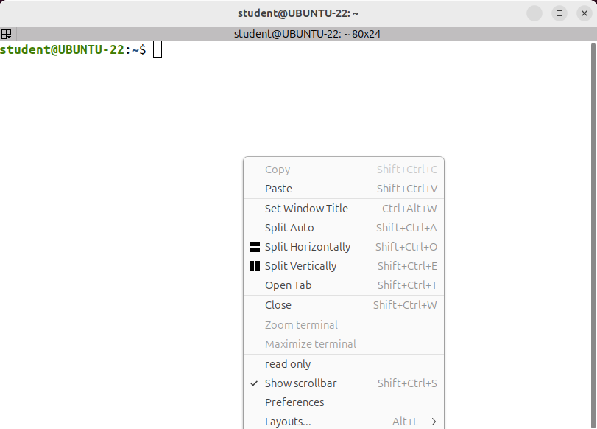
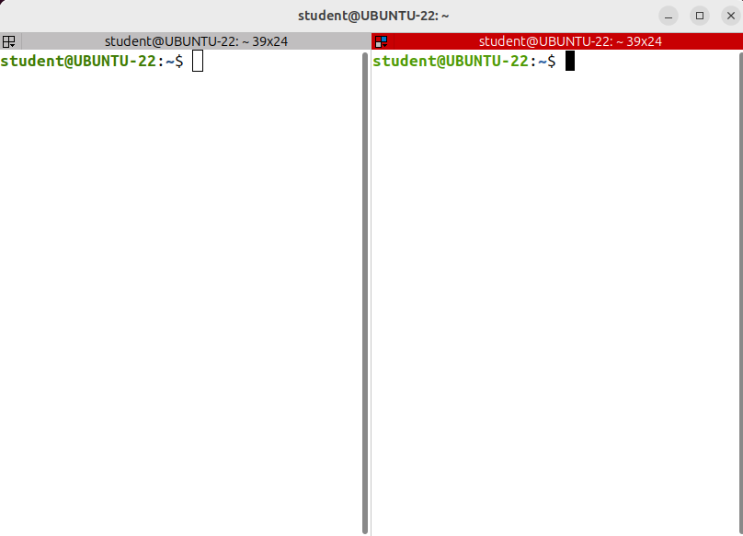
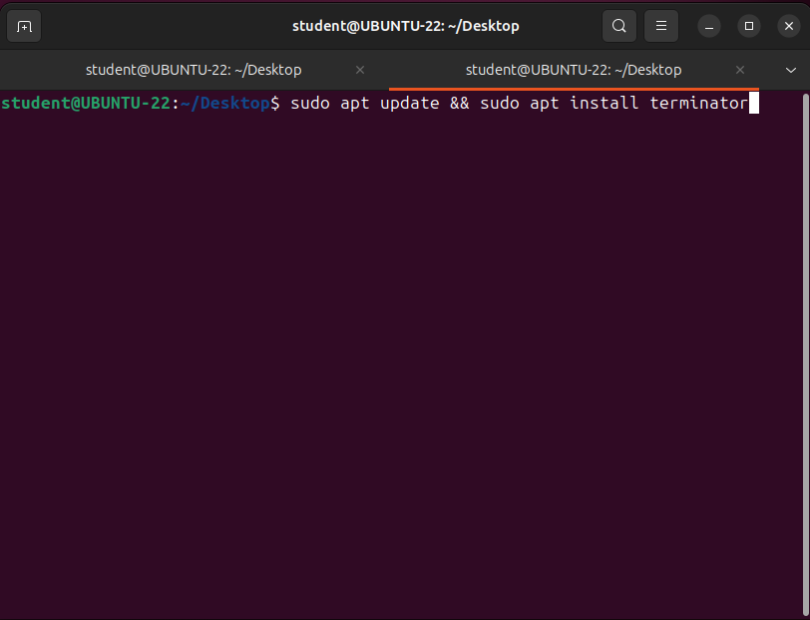
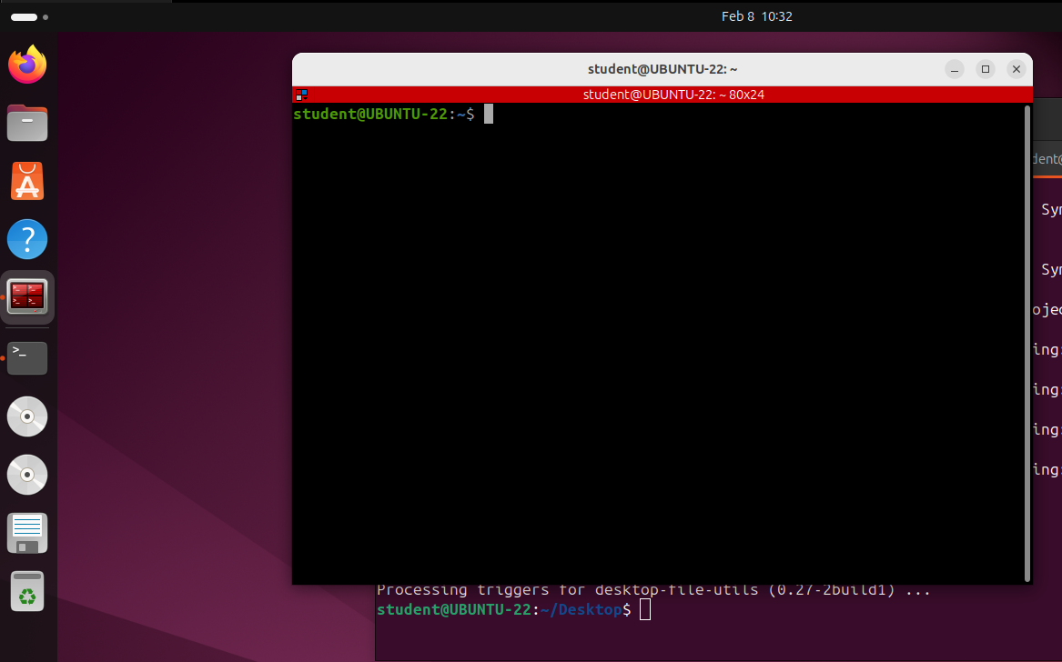
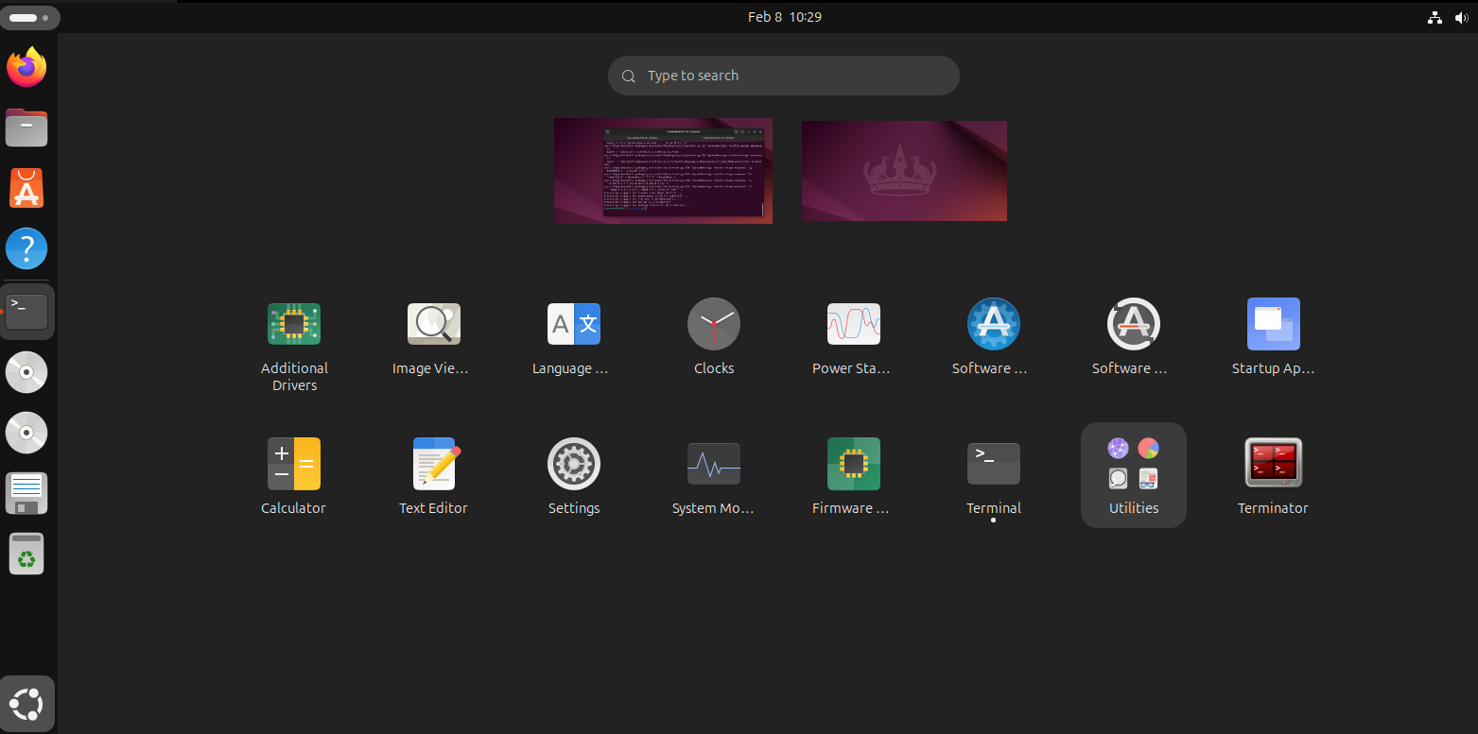
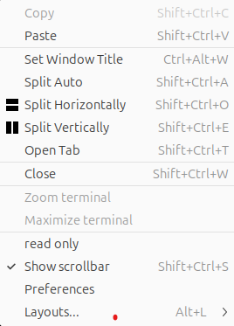

THE LINUX TERMINAL
Note that the gnome-terminal is not the only one. I'll install a new terminal emulator called Terminator, which provides several features that the default terminal application does not support. A useful feature is the ability to create multiple terminals in one window.
So in the gnome terminal, I'm writing:
sudo apt update && sudo apt install terminator

Slide 5
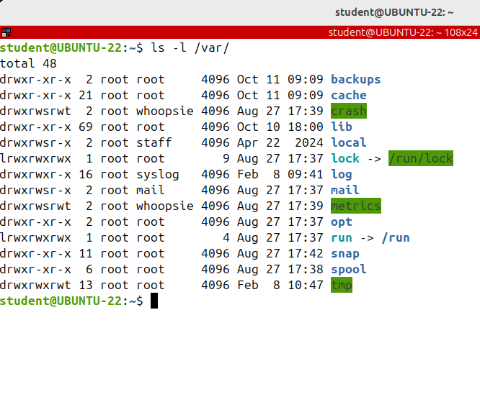
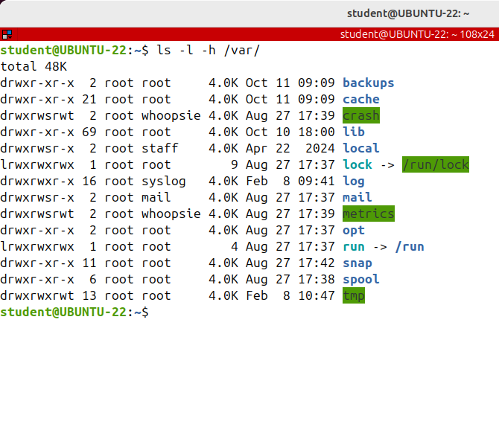
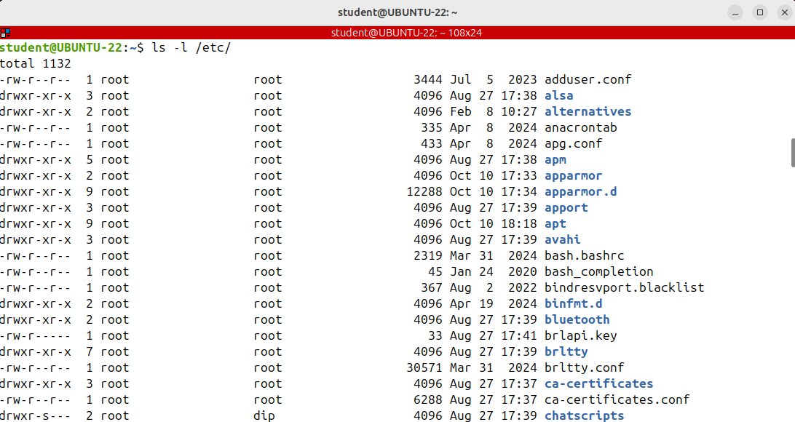
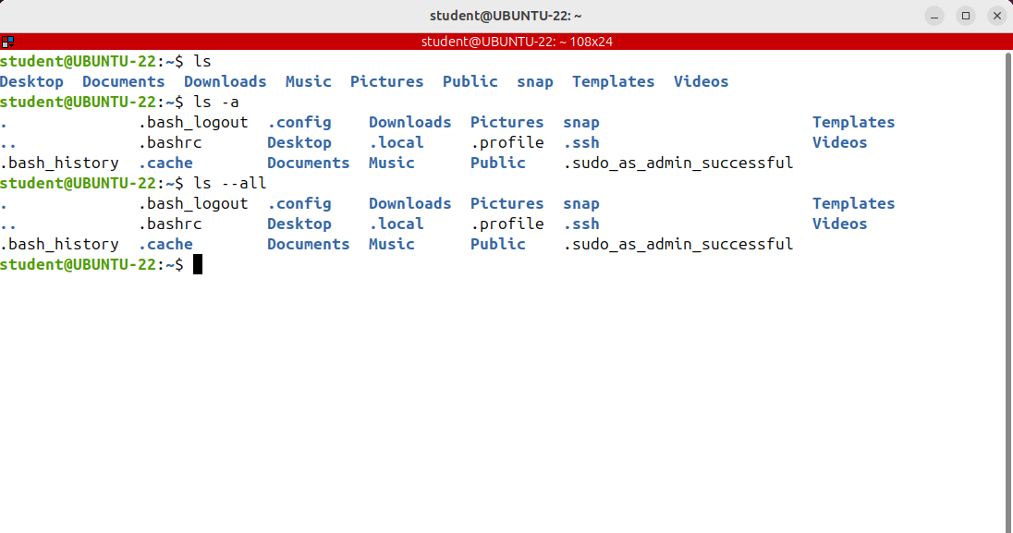
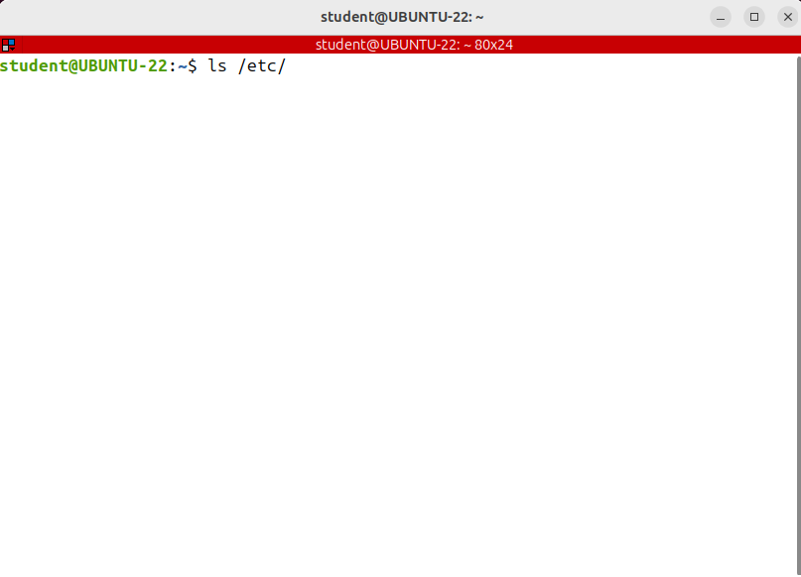
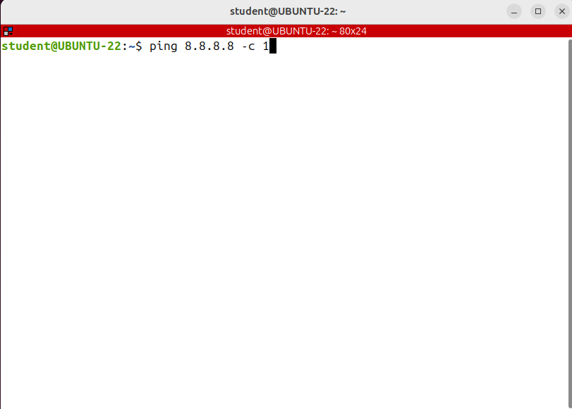
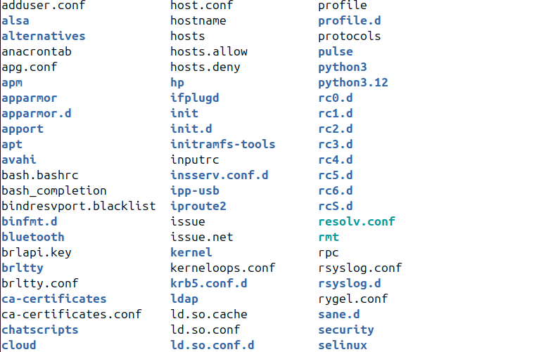
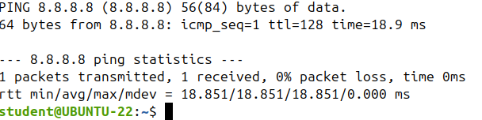
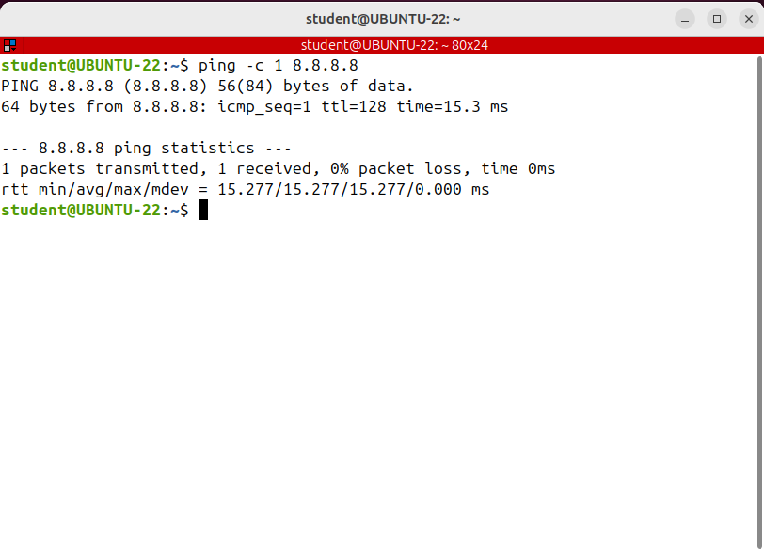
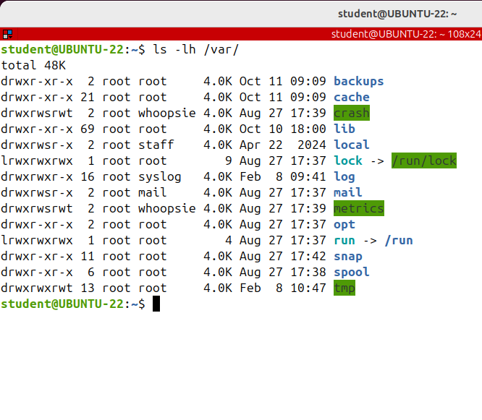
THE LINUX COMMAND STRUCTURE
Let's go ahead and discuss the structure of the Linux commands. To give a comment to a Linux system, you type in a shell, the command’s name, its options and arguments, if required.
It's important to know that all options are preceded by a hyphen, a minus sign.
Note the the command name, its options and arguments are always separated by one or more white spaces.
In fact, the shell knows that the command name ends where it sees the first white space.
Option Value
Option

Slide 6
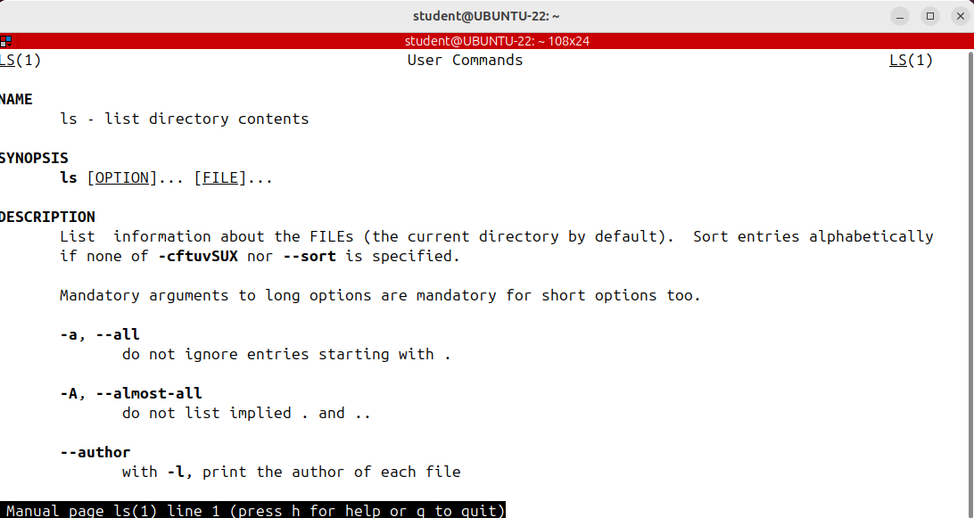
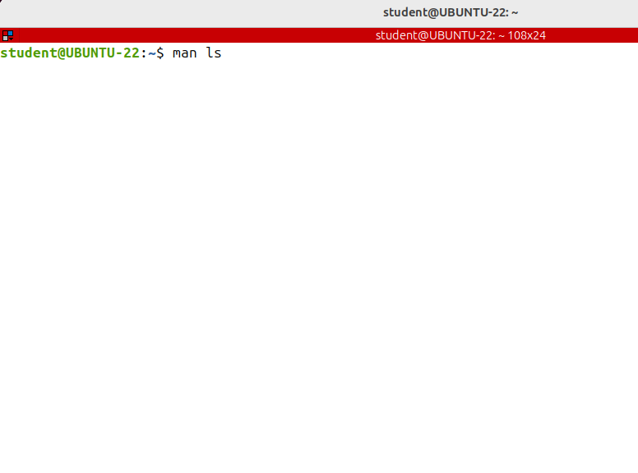
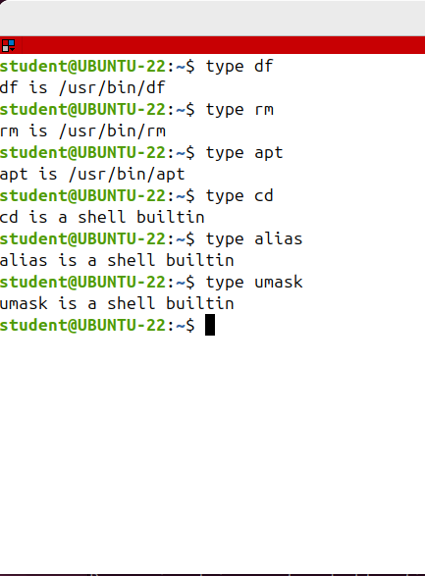
GETTING HELP, MAN PAGES
But another way to get some help is to write the name of the command and --help, this is
available for both shell builtin and executable files commands.
Linux comes with hundreds of commands, each of them with lots of options. It’s impossible, even for an experienced Linux administrator to remember all the all the commands and their options.
Fortunately, Linux comes with its own help built-in system
g -Beggining
G –End
F or spacebar – Forward window
B –Backwared window
For search: click on man window e press \ and word that you want to search
Example: /sort
I think you should now; also note that there are two types of commands in Linux:
-commands that are executable files on the disk
-shell built in commands.
The last ones are built into the shell and most of the time they don't have a dedicated man page.
Commands like cd, alias or umask are shell built-in and do not have a dedicated man page.
All these commands are shell built in.
To see the help of such a command instead of man use help command and the command name
help cd

Slide 7
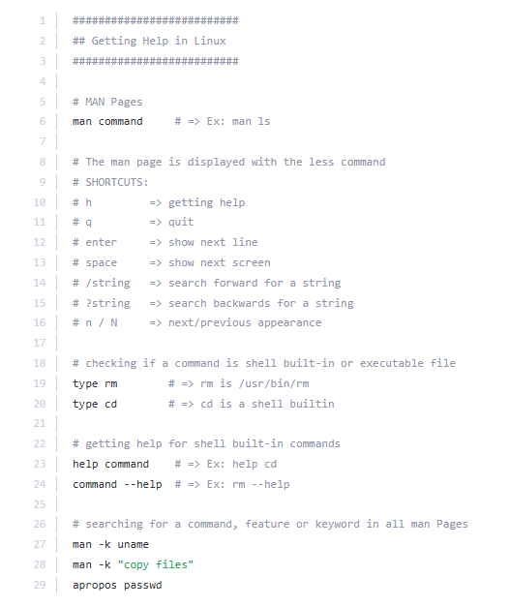
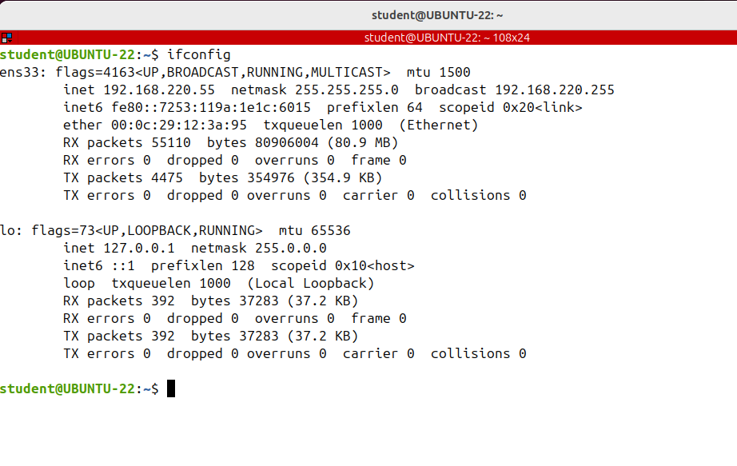
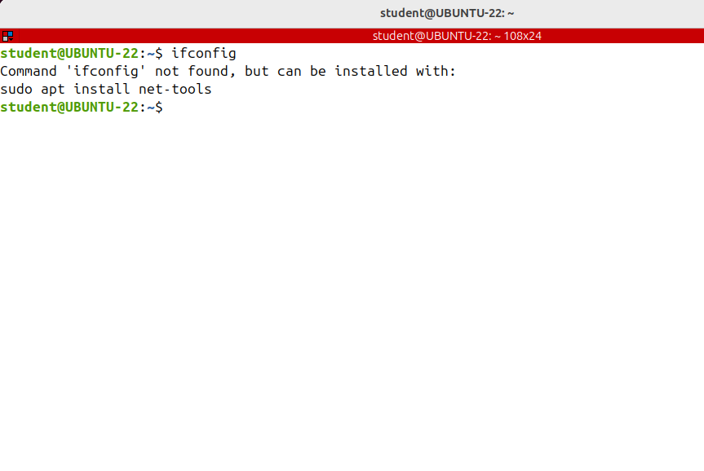
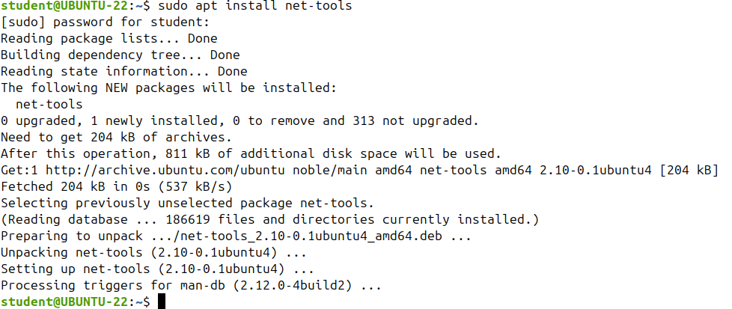
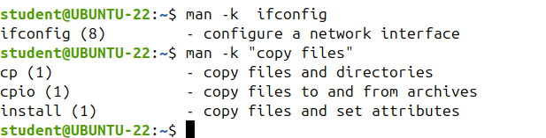
THE LINUX TERMINAL
I'll introduce you a new command, which is ifconfig.
This is used to both display information about the network interfaces and configure them.
If you want to see the IP or Mac address of a network interface, you have ifconfig at your disposal.
ifconfig belongs to net-tools package;
if, when running ifconfig , it says command not found then you should first install the net tools package.
The final trick I'd like to give you is how to search for a command, feature keyword in all man pages. To do that, use man -k and the keyword you are searching for.
man- k ifconfig

Slide 8
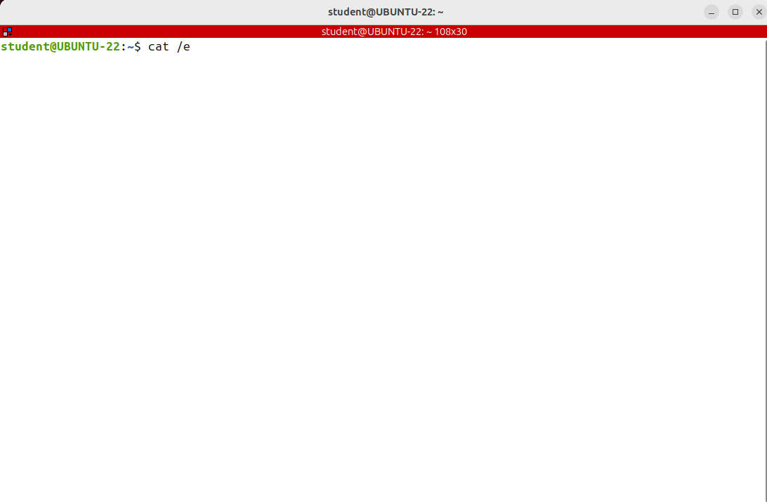
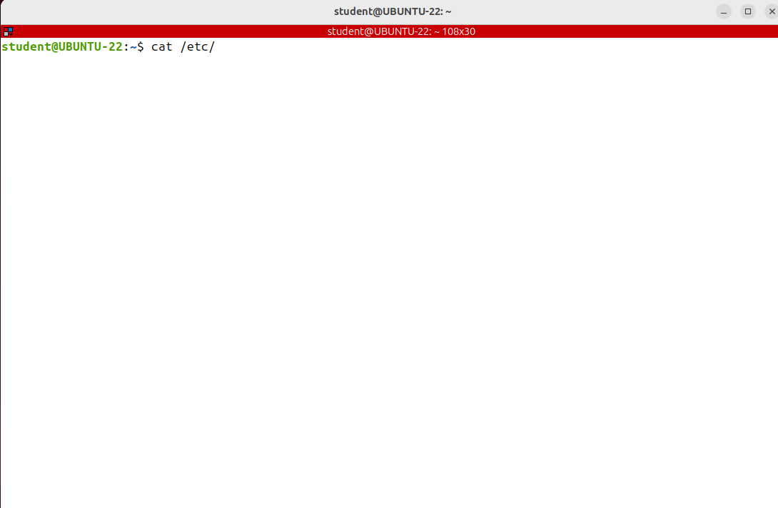
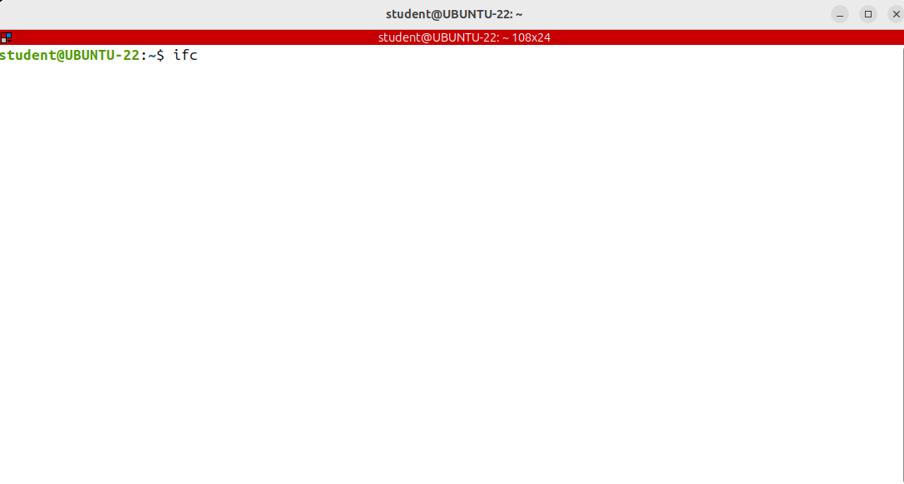
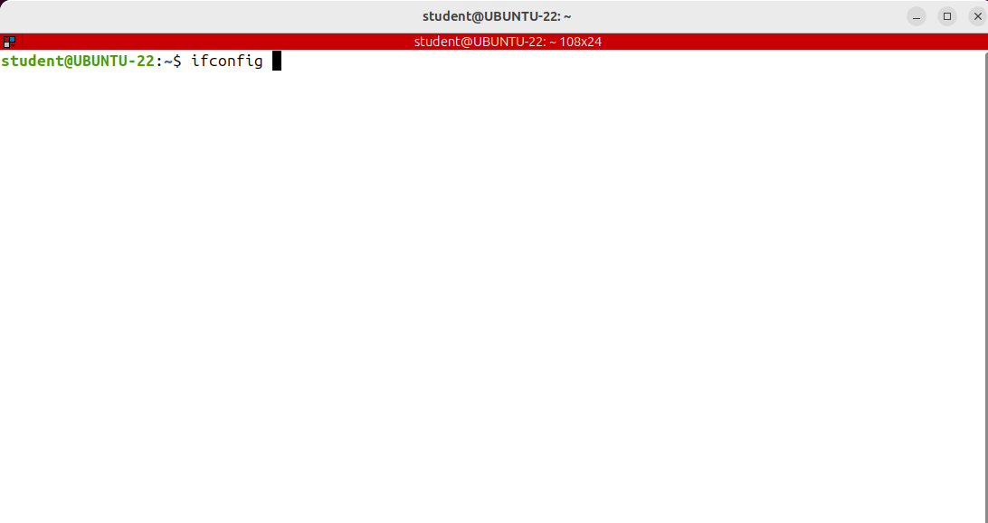
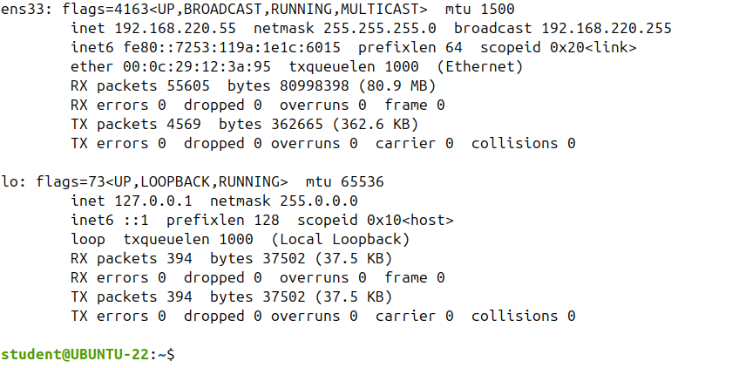
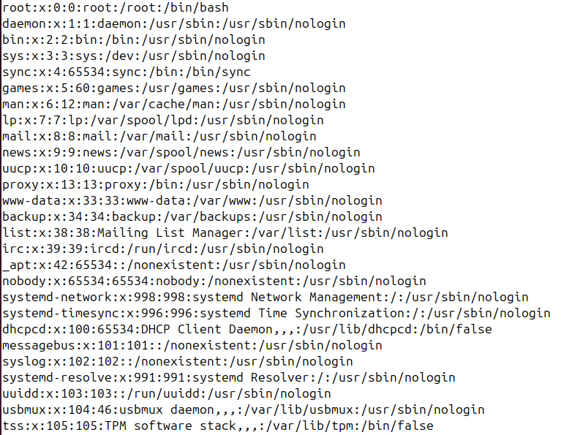
THE LINUX TERMINAL-THE TAB KEY
For any Linux professional user, the command line is an essential and ultra powerful tool.
I'll teach you how to be really efficient when using the terminal.
The most important advice I could give you is to use the TAB key for auto-completion.
This is something you cannot live without, it will not only save you so much time at the Linux command line, but it will keep you from making mistakes as well.
TAB is a feature supported by Bash and other shells as well.
How it works is really simple! When typing at the Linux command line, just use TAB to auto complete commands, filenames or folder names.
+ TAB TWICE
Now it's time to tell you something really important, something that, in my opinion is the key to not make serious mistakes while working in the Linux terminal. If TAB does not complete automatically a command or a filename when it should, then there is a mistake.
Do not continue writing the command or the file name, but stop and analyze what you have done up to that point.
Tab doesn't complete because somehow, somewhere there's an error.
+ TAB
+ TAB
+ TAB
+ TAB …..NOTHING HAPPEN…..BUT PRESS TAB TWICE….

Slide 9
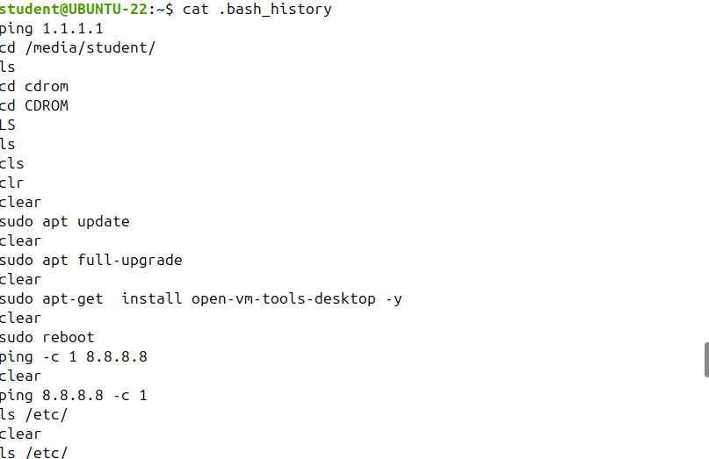
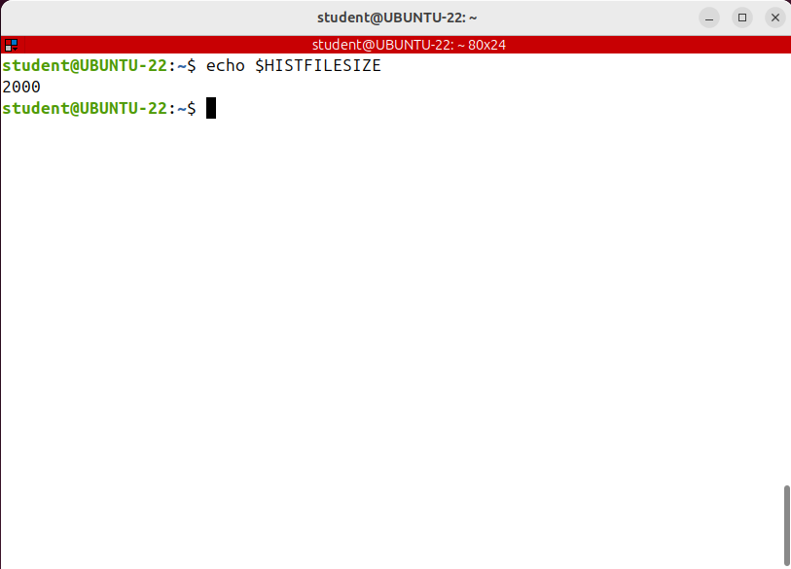
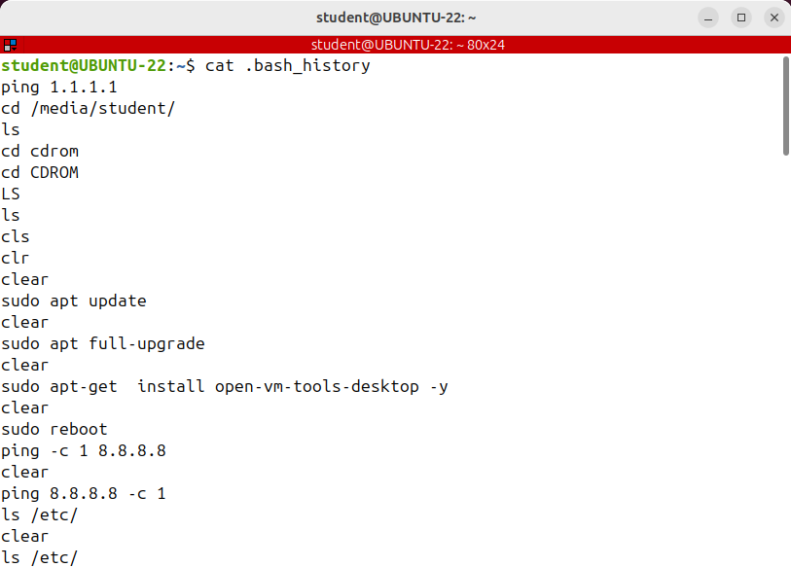
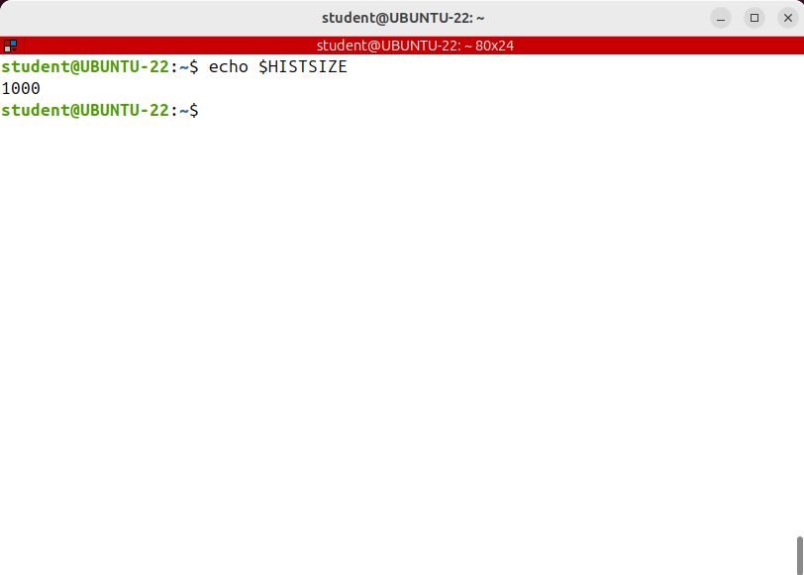
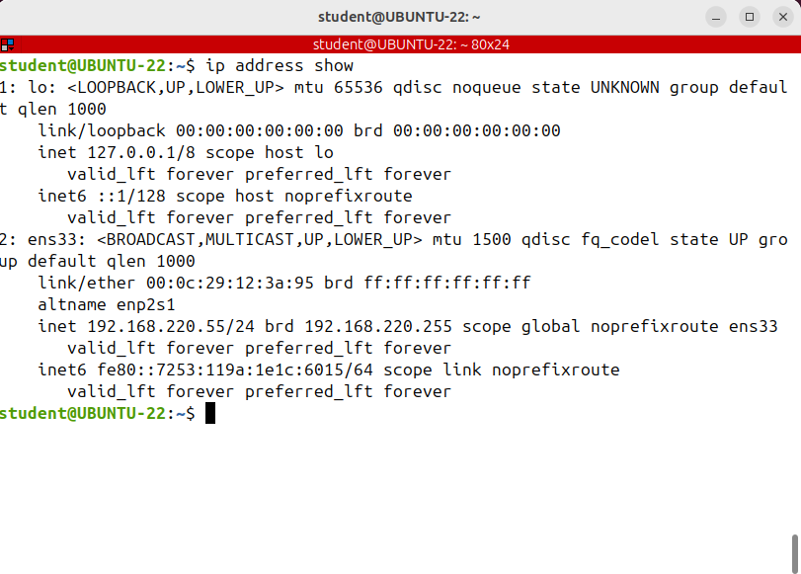
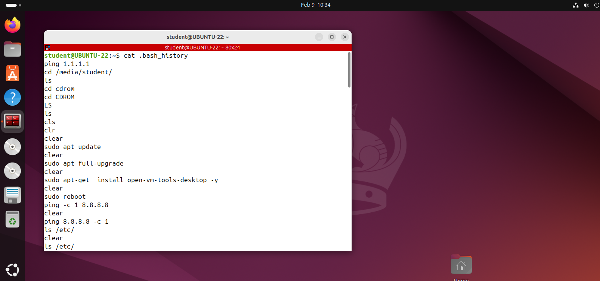
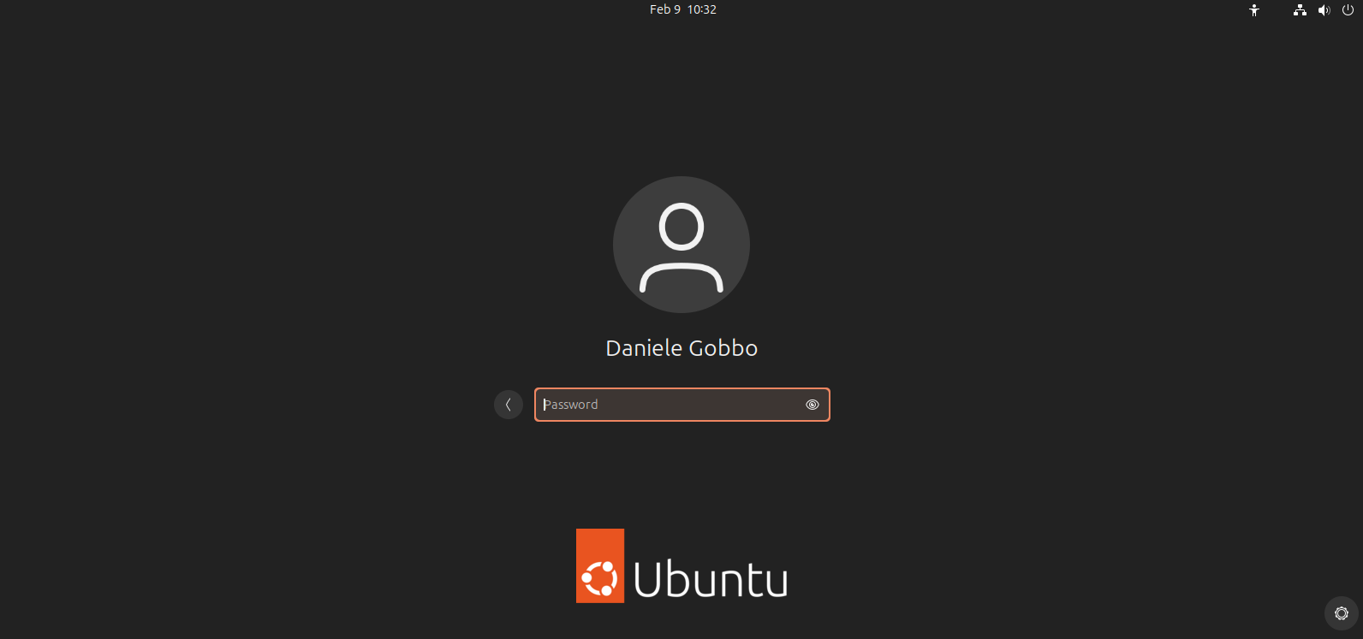
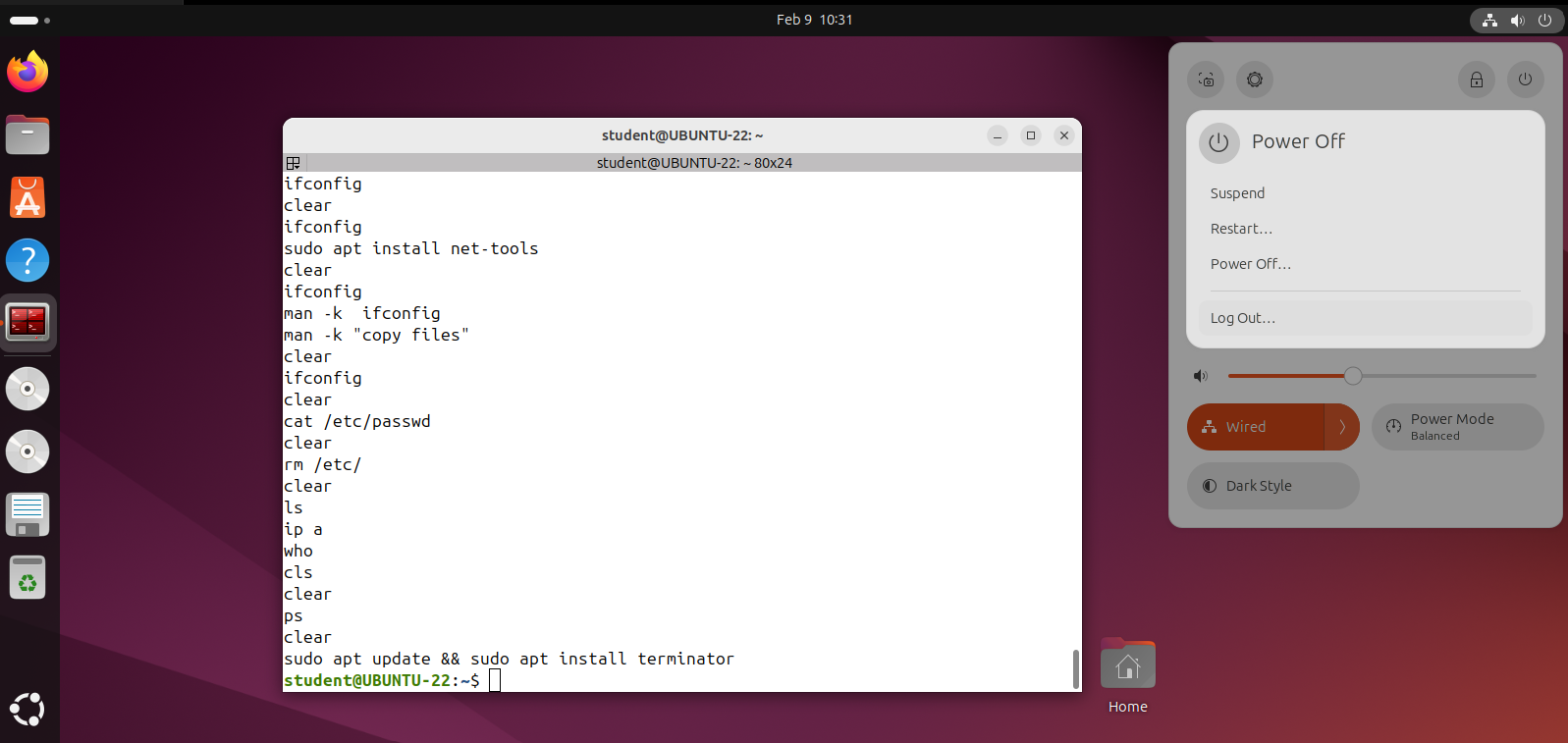
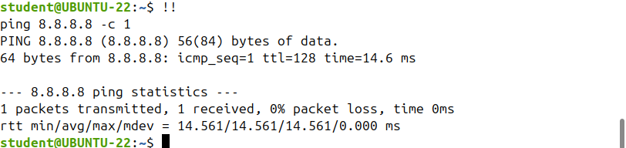
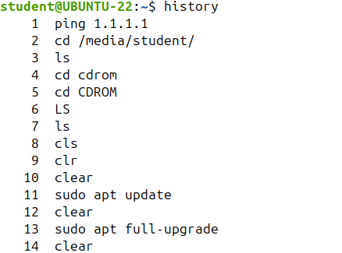
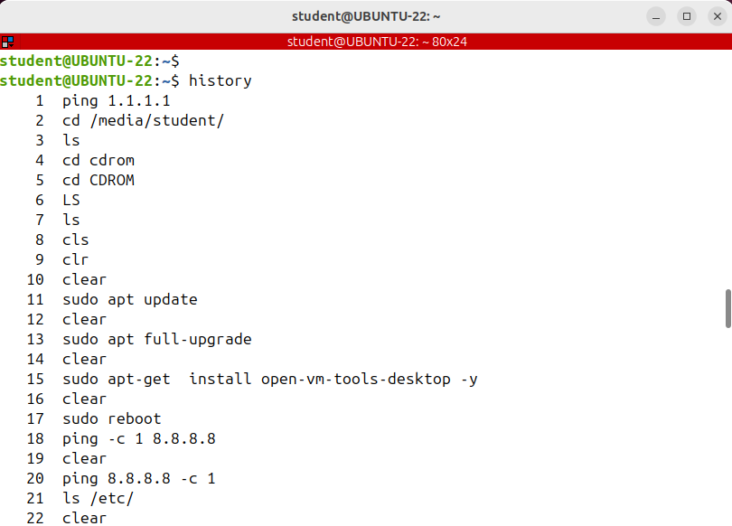
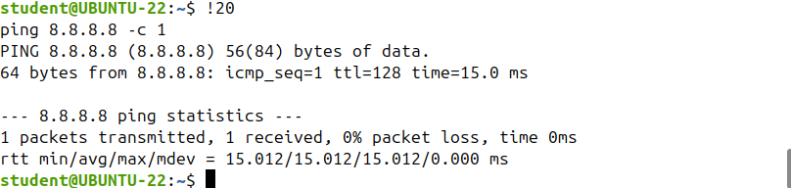



THE LINUX TERMINAL-THE BASH HISTORY
Let's talk about the Bash command history! The bash shell stores in the user's home directory.
The history of the commands each user has run in a file.
The file is .bash_history by default.
The number of commands then will be stored in the history file is controlled by an environment variable called HISTFILESIZE (written in uppercase letters).
To run a specific command from the history by it's no use an exclamation mark and the command number.
And to rerun the last command type two exclamation marks.
So the history command will display only half of the commands saved in the history file.
Also note that the history file is updated only when the user that run the commands logged out.

Slide 10
THE LINUX TERMINAL-THE BASH HYSTORY
You can also refer to a command from a certain number of lines, back in the bash history.
For example, !-3 would run the last 3th command.
There may come a time when you want to remove some or all the commands in your history.
If you want to delete a particular command enter history - d and the line number.
I have a small work assignment for you.
The command history is a very powerful feature of Bash and using it efficiently saves you a lot of time.
However, there are moments when you want to run a command without saving it to history; let's suppose you want to copy or view a file you are not supposed to, connect to another machine you are not allowed and so on.
How can you run the command without leaving any trace?
Think about it!
Control +P or up arrow are used to go to the previous command in the command history; press the shortcut multiple times to walk back through the history
control +N or down arrow will go to the next command in the command history; press the shortcut multiple times to walk forward through the history.
Bash also has a recall mode you can use to search for commands you've previously run; press control +R and the start typing a command to search your Bash history for it.
IF I do not want to run the command and I'm pressing control +G to leave the history searching mode and clear the line.
To clear the entire content of the history file, execute history -c. The entire history was removed

Slide 11

THE LINUX TERMINAL-BASH HYSTORY COMMANDS

Slide 12



THE LINUX TERMINAL-root vs Non-privileged Users. Getting root Access (sudo,su,passwd)
The root account is the most privileged on the system and has absolute power over it. Among its privileges are:
the ability to run any command or to access any file on the system.
installing a new software or updating the existing ones
setting up the network, changing the ownership of files
managing other users accounts
administering any service that's running.
Note that this is not the root password, it's the non privileged users password that run the command.
I'm entering the password, and if the password is right and the user is part of a specific group which
is called sudo on Ubuntu and wheel on CentOs
On many Linux distributions like those based on Debian or Ubuntu the direct logging in as root is prohibited.
Let’s see how to gain root access in the terminal!
There are more approaches and I'll show you all of them.
Because the root is so powerful, it's not recommended to use it for ordinary tasks such as browsing the web, writing e-mails or documents.
Even a simple mistake, like, for example, a mistyped command can cause problems to the entire system.
So for ordinary tasks, it's highly recommended to use a normal user account.
Superuser do
Substitute user

Slide 13









THE LINUX TERMINAL-TERMINAL-root vs Non-privileged Users. Getting root Access (sudo,su,passwd)
The last method of running commands as root is to temporarily become root in that terminal by running the su command and entering the root password.
Note that on some distributions like Ubuntu based, this method is by default disabled because direct access to root is locked.
Remember that you have installed Ubuntu in the first place without setting a password for the root account.
To unlock the account on such a distribution, you simply have to set its password.
Note that not having a password doesn't mean that without it you can login as root. But on contrary, it means that you cannot login at all.
I'm setting the root password.
A second way to run commands as root is without logging into the root account, but by using the sudo command and the command you want to run as root.
By running sudo with the -v option a user can update the cached credentials without running a command.
And if I want to invalidate the user's cached credentials, I need to run sudo-k
This command prints out the logged in user and the groups it belongs to. To log out, you type exit or
press Ctrl + d.
The current working directory was changed to the root home directory.
This executed all of the root users shall initialization scripts and set all environmental variables
as if the root user was logged into a fresh shell session.
And you notice that the command ran as root without asking for any password, as in the first example when I ran the sudo command. That's because the sudo policy caches for five minutes, the credentials

Slide 14


THE LINUX TERMINAL-CHALLENGES

Slide 15


THE LINUX TERMINAL-CHALLENGES

Slide 16


THE LINUX TERMINAL-CHALLENGES

Slide 17







THE LINUX TERMINAL-CHALLENGES

Slide 18





THE LINUX TERMINAL-CHALLENGES

Slide 19
THE LINUX TERMINAL-THE TAB KEY

Slide 20
THE LINUX TERMINAL-THE TAB KEY

